Slide 1


INTRODUCING ECO-BIN REVOLUTIONIZING WASTE MANAGEMENT
PRESENTATION
PRESENTED BY ADIL, ALI FIDHAN, AFLEH, JITHIN

Slide 2


ABOUT ECO-BIN
Welcome to ECO-BIN, a groundbreaking web application designed to transform the way waste collection and management are handled. Our platform aims to make waste disposal more efficient, convenient, and environmentally responsible.

Slide 3


DEPOSITOR
WORKER
Registration
Request waste pick-up
Payment
Confirmation
Tracking and analytics
Registration
Dashboard access
Acceptance or decline offer
Navigation to location
Collection and disposal
Payment

Slide 4


WHY ECO-BIN?
Convenience
Cost Savings
Transparency and Accountability
Environmental and society Impact

Slide 5

VISION AND MISSION
VISION
Our vision at ECO-BIN is to create a world where waste management is efficient, transparent, and environmentally responsible. We envision a future where every individual and organization can easily access waste collection services, contribute to recycling efforts, and minimize their environmental footprint.
MISSION
At ECO-BIN, our mission is to revolutionize waste management through innovative technology solutions. We are committed to: Providing Convenience, Promoting Accountability, Encouraging Sustainability, and Driving Innovation

Slide 6


REAL-LIFE
SOLUTIONS
Inefficient Waste Collection Services
Environmental Pollution
Lack of Transparency and Accountability
Financial Losses Due to Missed Collections
Limited Access to Recycling Facilities
Inconvenience in Waste Disposal

Slide 7
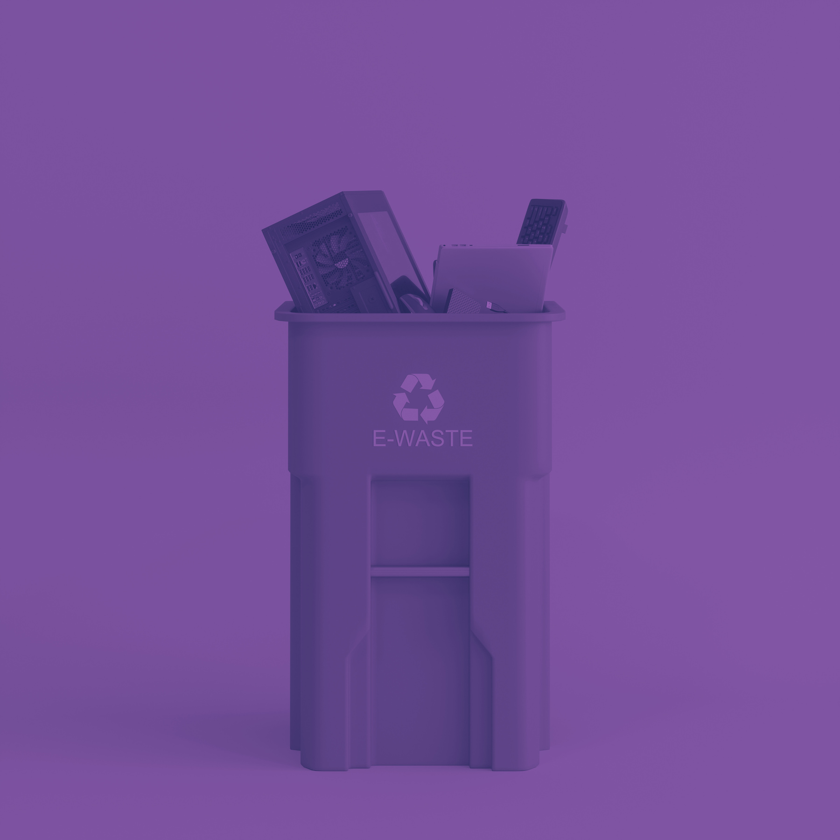
ECO-BIN
THANK YOU
FOR YOUR ATTENTION

